Slide 1
IT628: Systems Programming
I/O: syscalls vs stdio functions

Slide 2
char buf[10];
int fd, x, y, z;
fd = open(“data.txt”, O_RDONLY);
read(fd, buf, 2); buf[2] = 0;
x = atoi(buf);
read(fd, buf, 2); buf[2] = 0;
y = atoi(buf);
read(fd, buf, 2); buf[2] = 0;
z = atoi(buf);
printf(“%d %d %d”, x, y, z);
data.txt
102030
10 20 30

Slide 3
char buf[10];
int fd, x, y, z;
fd = open(“data.txt”, O_RDONLY);
read(fd, buf, 2); buf[2] = 0;
x = atoi(buf);
read(fd, buf, 2); buf[2] = 0;
y = atoi(buf);
read(fd, buf, 2); buf[2] = 0;
z = atoi(buf);
printf(“%d %d %d”, x, y, z);
data.txt
102030
system call | return value
open(“data.txt”, O_RDONLY) | 3
read(3, “10”, 2) | 2
read(3, “20”, 2) | 2
read(3, “30”, 2) | 2
write(1, “10 20 30”, 8) | 8

Slide 4
char buf[10];
int fd, x, y, z;
fd = open(“data.txt”, O_RDONLY);
read(fd, buf, 2); buf[2] = 0;
x = atoi(buf);
read(fd, buf, 2); buf[2] = 0;
y = atoi(buf);
read(fd, buf, 2); buf[2] = 0;
z = atoi(buf);
printf(“%d %d %d”, x, y, z);
data.txt
102030
one syscall per integer read = inefficient!!!

Slide 5
solution: buffering

Slide 6
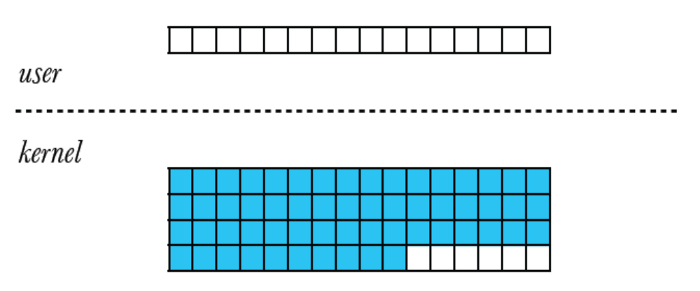
step 1: read more bytes than we need into a separate
backing buffer

Slide 7
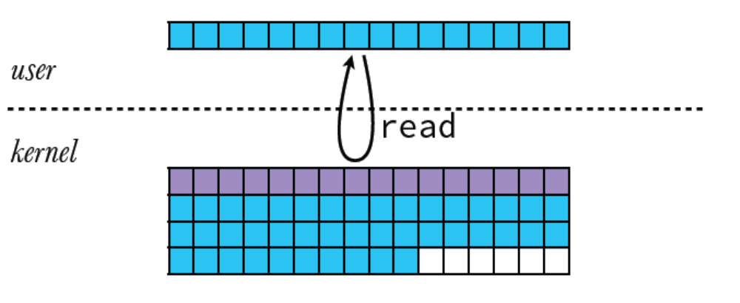
step 1: read more bytes than we need into a separate
backing buffer

Slide 8
char buf[10], char bbuf[80];
int fd, x, y, z;
fd = open(“data.txt”, O_RDONLY);
read(fd, bbuf, sizeof(bbuf));
data.txt
102030

Slide 9
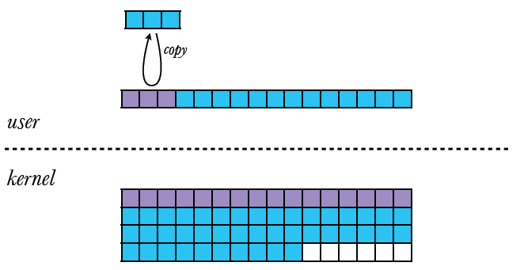
step 2: avoid syscalls and process future “reads” from
that buffer

Slide 10
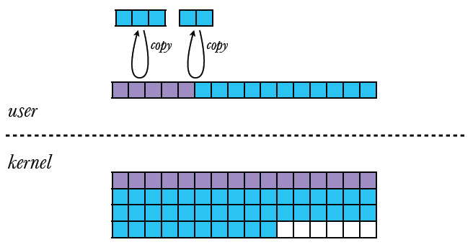
step 2: avoid syscalls and process future “reads” from
that buffer

Slide 11
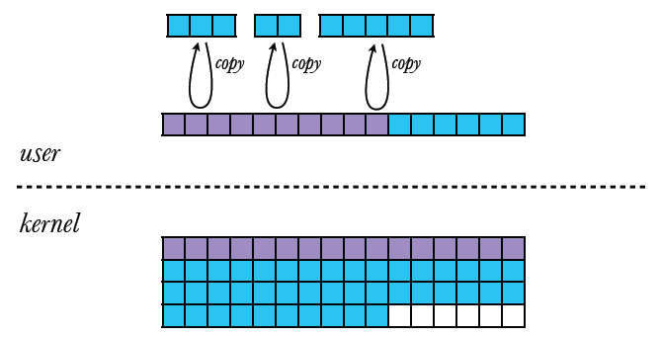
step 2: avoid syscalls and process future “reads” from
that buffer

Slide 12
char buf[10], bbuf[80];
int fd, x, y, z;
fd = open(“data.txt”, O_RDONLY);
read(fd, bbuf, sizeof(bbuf));
buf[2] = 0;
memcpy(buf, bbuf, 2);
x = atoi(buf);
buf[2] = 0;
memcpy(buf, bbuf+2, 2);
y = atoi(buf);
buf[2] = 0;
memcpy(buf, bbuf+4, 2);
z = atoi(buf);
data.txt
102030

Slide 13
char buf[10], bbuf[80];
int fd, x, y, z;
fd = open(“data.txt”, O_RDONLY);
read(fd, bbuf, sizeof(bbuf));
buf[2] = 0;
memcpy(buf, bbuf, 2);
x = atoi(buf);
buf[2] = 0;
memcpy(buf, bbuf+2, 2);
y = atoi(buf);
buf[2] = 0;
memcpy(buf, bbuf+4, 2);
z = atoi(buf);
data.txt
102030
system call | return value
open(“data.txt”, O_RDONLY) | 3
read(3, “102030\n”, 80) | 7
write(1, “10 20 30”, 8) | 8

Slide 14
to generalize, bundle together:
(1) FD
(2) backing buffer
(3) num unused bytes
(4) pointer to next byte

Slide 15
typedef struct {
int fd; /* (1) wrapped FD */
char buf[100]; /* (2) backing buffer */
int count; /* (3) num unused bytes */
char *nextp; /* (4) pointer to next byte */
} bufio_t;
void bufio_init(bufio_t *bp, int fd) {
bp->fd = fd;
bp->count = 0;
bp->nextp = bp->buf;
}

Slide 16
ssize_t bufio_read(bufio_t *bp, char *buf, size_t n) {
int ncpy;
/* fill backing buffer if empty */
if (bp->count <= 0) {
bp->count = read(bp->fd, bp->buf, sizeof(bp->buf));
if (bp->count <= 0)
return bp->count; /* EOF or read error */
else
bp->nextp = bp->buf; /* re-init buf position */
}
/* copy from backing buffer to user buffer */
ncpy = (bp->count < n) ? bp->count : n;
memcpy(buf, bp->nextp, ncpy);
bp->nextp += ncpy;
bp->count -= ncpy;
return ncpy;
}

Slide 17
char buf[10];
int fd, x, y, z;
bufio_t bbuf;
fd = open(“data.txt”, O_RDONLY);
bufio_init(&bbuf, fd);
buf[2] = 0;
bufio_read(&bbuf, buf, 2);
x = atoi(buf);
bufio_read(&bbuf, buf, 2);
y = atoi(buf);
bufio_read(&bbuf, buf, 2);
z = atoi(buf);
data.txt
102030

Slide 18
open is now a distraction … we never use the FD directly (except to initialize buffer)
next step: hide syscalls from user – wrap open
together with buffer initialization

Slide 19
bufio_t *buf_open(const char *path) {
bufio_t *buf = malloc(sizeof(bufio_t));
int fd = open(path, O_RDWR);
bufio_init(buf, fd);
return buf;
}
int main() {
bufio_t *bbuf = buf_open(“data.txt”);
char buf[10];
int x, y, z;
bufio_read(bbuf, buf, 2);
}

Slide 20
Stop!
Standard library I/O functions do all this for us!

Slide 21
fclose fdopen feof ferror
fflush fgetc fgetln fgetpos
fgets fopen fprintf fputc fputs
fread freopen fscanf fseek
fsetpos fwrite getc mktemp
perror printf putc putchar puts
remove rewind scanf sprintf
sscanf strerror tmpfile ungetc
vfprintf vprintf vscanf …
… all use buffered I/O

Slide 22
stdio functions operate on stream objects
i.e., buffered wrappers on FDs

Slide 23
FILE* fopen ( const char *filename, const char *mode );
FILE* fdopen ( int fd, const char *mode);
int fclose ( FILE *stream );
int fseek ( FILE *stream, long offset, int whence );
ssize_t fread ( void *ptr, size_t size, size_t nitems, FILE *stream );
ssize_t fwrite ( void *ptr, size_t size, size_t nitems, FILE *stream );
int fprintf( FILE *stream, const char *format, ...);
int fscanf ( FILE *stream, const char *format, ...);
char* fgets ( char *str, int size, FILE *stream );

Slide 24
int x, y, z;
FILE *infile = fopen(“data.txt”, “r”);
fscanf(infile, “%2d”, &x);
fscanf(infile, “%2d”, &y);
fscanf(infile, “%2d”, &z);
printf(“%d %d %d”, x, y, z);
fclose(infile); /* or memory leak */
system call | return value
open(“data.txt”, O_RDONLY) | 3
read(3, “102030\n”, 4096) | 7
write(1, “10 20 30”, 8) | 8
close(3) | 0

Slide 25
printf(“h”);
printf(“e”);
printf(“l”);
printf(“l”);
printf(“o”);
system call | return value
write(1, “hello”, 5) | 5
(writes are buffered too!)

Slide 26
stream buffer can absorb multiple writes before being flushed to underlying file

Slide 27
flush happens on:
buffer being filled
(normal) process termination
newline, in a line-buffered stream
explicitly, with fflush

Slide 28
int main() {
printf(“h”);
printf(“e”);
printf(“l”);
printf(“l”);
printf(“o”);
fork();
}
hellohello
@#$%^&*!!!

Slide 29
int n;
char buf[10];
fd = open(“fox.txt”, O_RDONLY);
n = read(fd, buf, sizeof(buf));
write(1, buf, n);
if (fork() == 0) {
n = read(fd, buf, sizeof(buf));
write(1, buf, n);
exit(0);
}
wait(NULL);
n = read(fd, buf, sizeof(buf));
write(1, buf, n);
printf(“%d %d %d”, x, y, z);
fox.txt
the quick brown
fox jumps over
the lazy dog
the quick brown fox jumps over

Slide 30
int n;
char buf[10];
FILE *stream = fopen(“fox.txt”, “r”);
n = fread(buf, 1, sizeof(buf), stream);
write(1, buf, n);
if (fork() == 0) {
n = fread(buf, 1, sizeof(buf), stream);
write(1, buf, n);
exit(0);
}
wait(NULL);
n = fread(buf, 1, sizeof(buf), stream);
write(1, buf, n);
printf(“%d %d %d”, x, y, z);
fox.txt
the quick brown
fox jumps over
the lazy dog
the quick brown fox brown fox
@#$%^&*!!!

Slide 31
things get even more confusing when we perform both input and output

Slide 32
char buf[10];
fd = open(“fox.txt”, O_RDWR);
/* output followed by input */
write(fd, “a playful ”, 10);
read(fd, buf, sizeof(buf));
write(1, buf, sizeof(buf));
fox.txt
a playful brown
fox jumps over
the lazy dog
brown fox

Slide 33
char buf[10];
int fd = open(“fox.txt”, O_RDWR);
FILE *stream = fdopen(fd, “r+”);
/* output followed by input */
fwrite(“a playful ”, 1, 10, stream);
read(fd, buf, sizeof(buf));
write(1, buf, sizeof(buf));
fox.txt
the quick a
playful jumps over the lazy dog
the quick
@#$%^&*!!!

Slide 34
lessons:
buffered stdio functions help minimize system overhead & simplify I/O
use whenever possible!
but need to be aware of glitches
don’t mix buffered & unbuffered I/O

